Slide 1
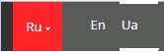


Logo
+38 067 454 54 54
projectplus31@gmail.com
We provide a unique solution
of Management Accounting
in compliance with your specific needs
Contact us today and we’ll provide a free consultation
to find solutions to challenges using software

Slide 2


+38 067 454 54 54
projectplus31@gmail.com
We provide a unique solution
of Management Accounting
in compliance with your specific needs
Contact us today and we’ll provide a free consultation
to find solutions to challenges using software

Slide 3








Services We Provide

Slide 4
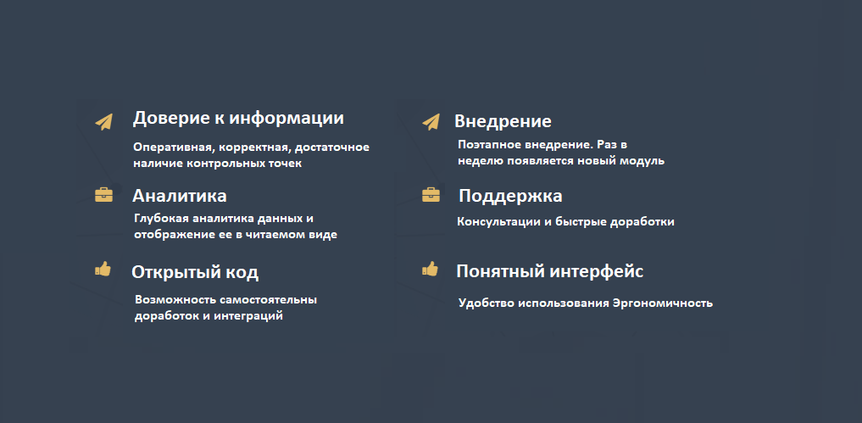
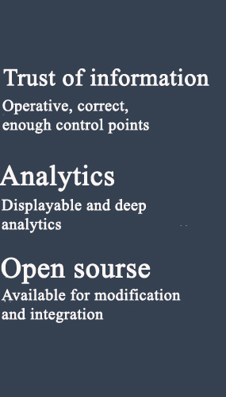
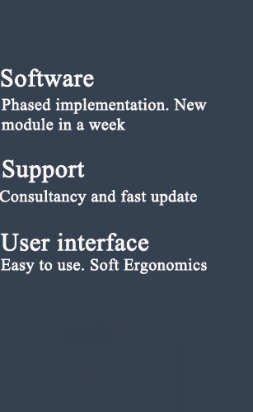






Our Advantages

Slide 5

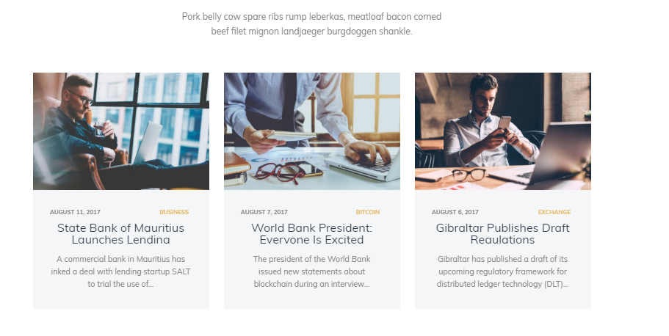






Our solutions:
Наш опыт
Заголовок решения
Заголовок решения
Заголовок решения
Краткое описание решения
Краткое описание решения
Краткое описание решения
Краткое описание решения
Краткое описание решения
Краткое описание решения

Slide 6







We create unique solutions for various spheres
Food industry
Pharmacies
Clothes and Shoes shops

Slide 7
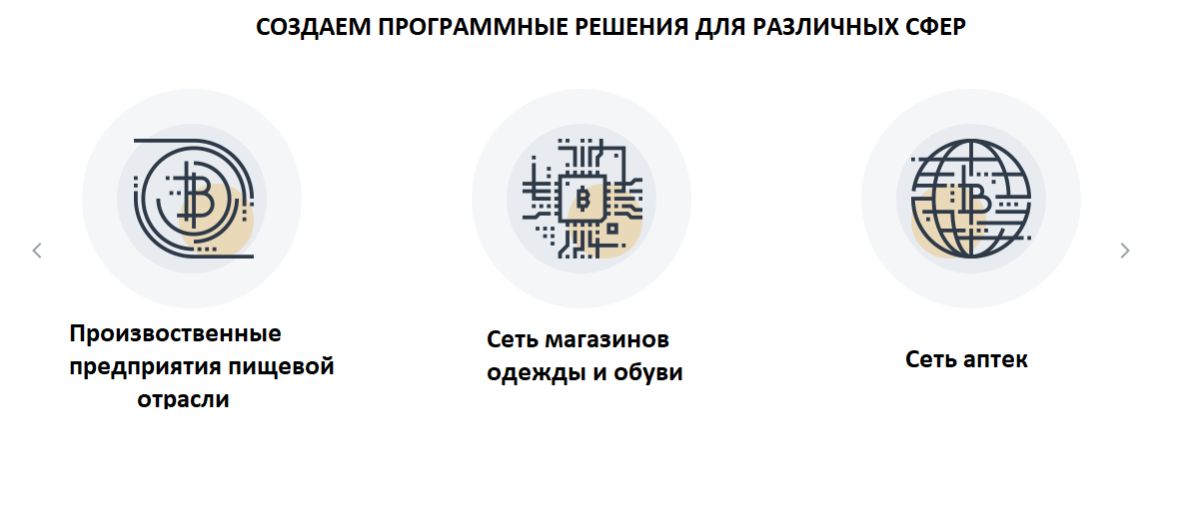






We create unique solutions for various spheres
Advertising and Marketing
Catering
Tourism

Slide 8


Our positive experience
Наш опыт
Лучше свой автопарк или
арендовать автомобили?
Как правильно делать анализ
маркетинговых акций
Как выбор ассортимента
влияет на выручку
Краткое описание опыта
Краткое описание опыта
Краткое описание опыта
Краткое описание опыта
Краткое описание опыта
Краткое описание опыта

Slide 9
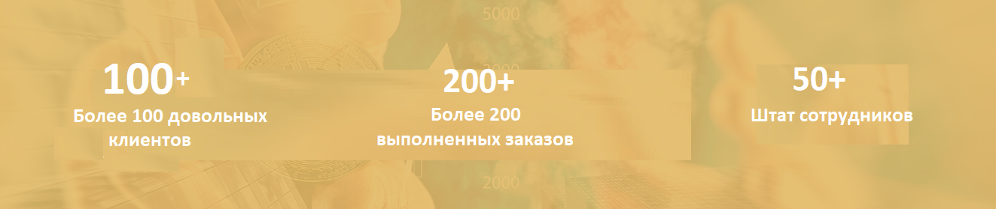

Our Company in Numbers

Slide 10


The Stages of a Project
From contact with us to celebrating success
Meeting with our expert,
presentation.
Discussion the problem.
Estimation of costs and
project deadlines
Preparation of technical
Specifications (TS)
and accurately
estimation of costs
Contract assignment
Analysis of business processes.
System design
We provide up to 200
free hours for modifications
in the first two months after
the implementation
Launching in
the operating mode
Development and implementation
by stages
Matching
interface design

Slide 11

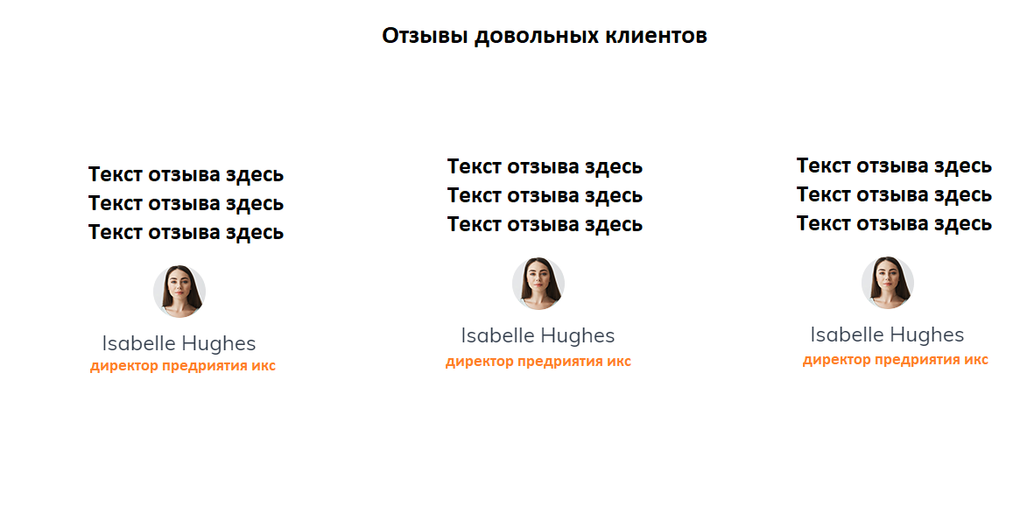

Хохова Вера Николаевна
Хохова Вера Николаевна
Хохова Вера Николаевна

Slide 12


Why would you Need Management Accounting?

Slide 13

Why would you Need Management Accounting?
Management Accounting is not only cost accounting. Management Accounting handle many facets of internal business analysis across all the activities and processes, which are kept in-house. These include not only valuation and product costing, but also sales, stocks, clients, competitor analysis, trends and forecasting.
The main aim of Management Accounting is acting as a Decision Support System. That is, the Management Accounting instruments, help business leaders to use to drive decision-making and conceive the long-term vision and strategy.
Almost 90% of companies want a specialist “methodologist”. He determines how many reports should be and who should prepare them. What indicators will be used and what formulas need for getting the data in the reports. In consequence, companies often faced with the problem, when the Profit exist, but there is no Money.
Wrongly to manage the accounting based on the accounting chart of accounts. Understanding all of the above, our company of experts helps to build a high quality Management Accounting, which acts as a Decision Support System for top managers.

Slide 14



1B Kosmicheskaya Str., Kiev

Slide 15
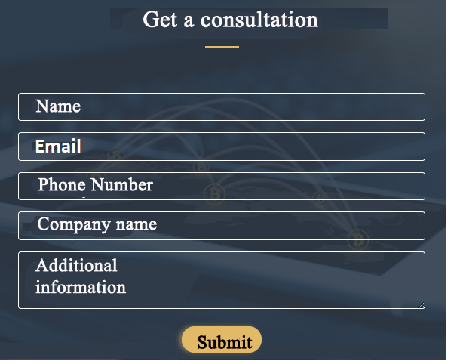

Slide 16
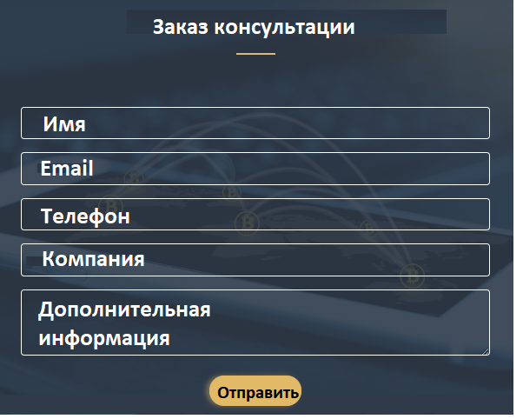

После заполнения заказа консультации появляется такое окно
Your consultation request has been processed!
We will contact you
soon!

Slide 17

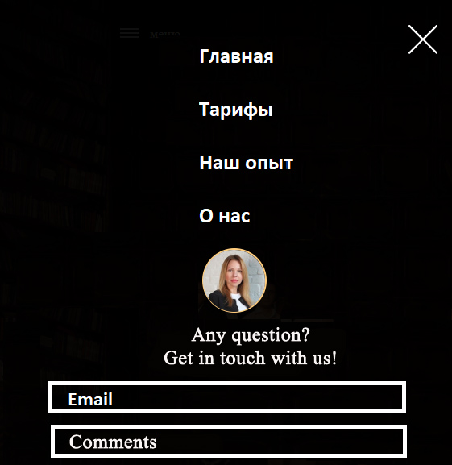

Home
Solutions
Our success
Vacancies
About us
Submit

Slide 18
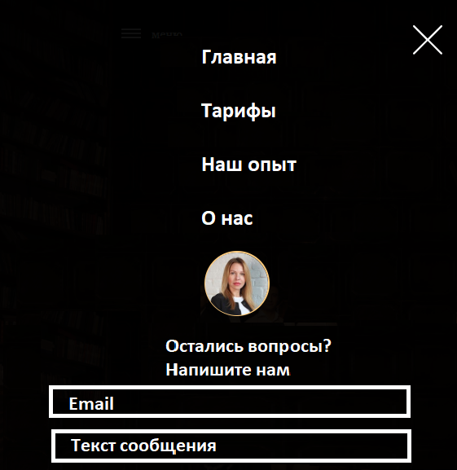

После отправки вопроса в разделе МЕНЮ появляется такое окно
Home
Solutions
Our success
Vacancies
About us
Thank you for your request!
We will contact you
as soon as possible!
Отправить

Slide 19

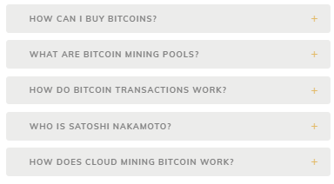
Перешли в раздел наши решения из Меню
Наш опыт
Logistics
Employees
Краткое описание Статья 1 из раздела наши решения
Stock
Production
Distribution
Краткое описание Статья 2 из раздела наши решения

Slide 20


Статья из блока Наши решения
Название статьи

Slide 21
Перешли в раздел наш Опыт из Меню
Наш опыт
Logistics
Employees
Краткое описание Статья 1 из раздела наш Опыт
Stock
Production
Distribution
Краткое описание Статья 2 из раздела наш Опыт

Slide 22
Статья из блока Наш опыт

Slide 23





Current vacancies
Вакансии
Business Process Specialist
Business Process Specialist
Project manager

Slide 24


Открытые вакансии
Вакансии
Специалист по бизнес-процессам
Специалист по бизнес-процессам
Описание Вакансии
Project manager

Slide 25

Job Description
Apply for this vacancy

Slide 26
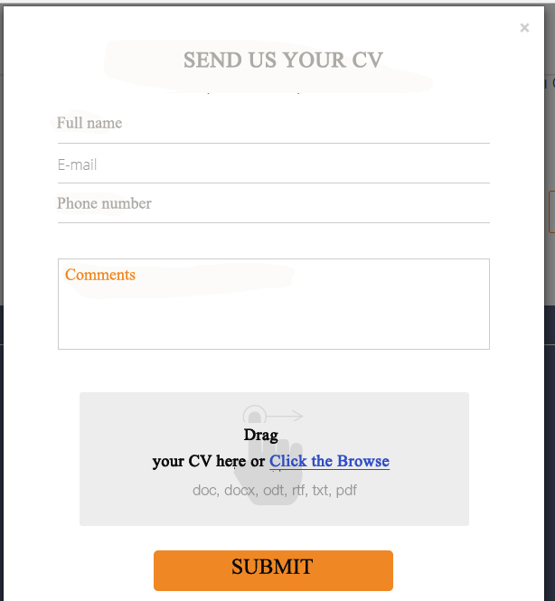
Форма отправки резюме

Slide 27
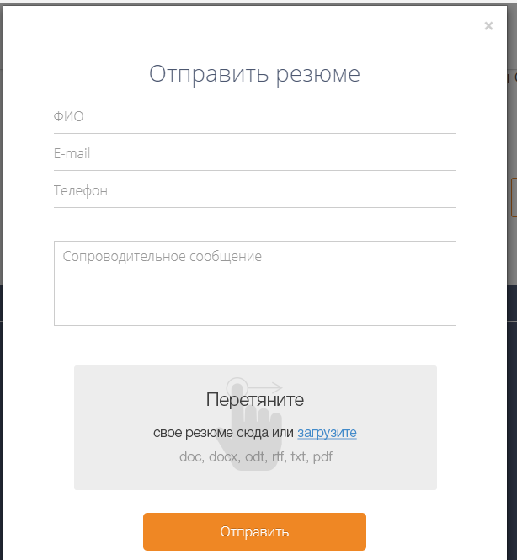

После отправки резюме
Your CV has been successfully sent! We will check it and give you feedback in the near future!

Slide 28


About us
Текст о истории создания компании и ее развитии

